Slide 1
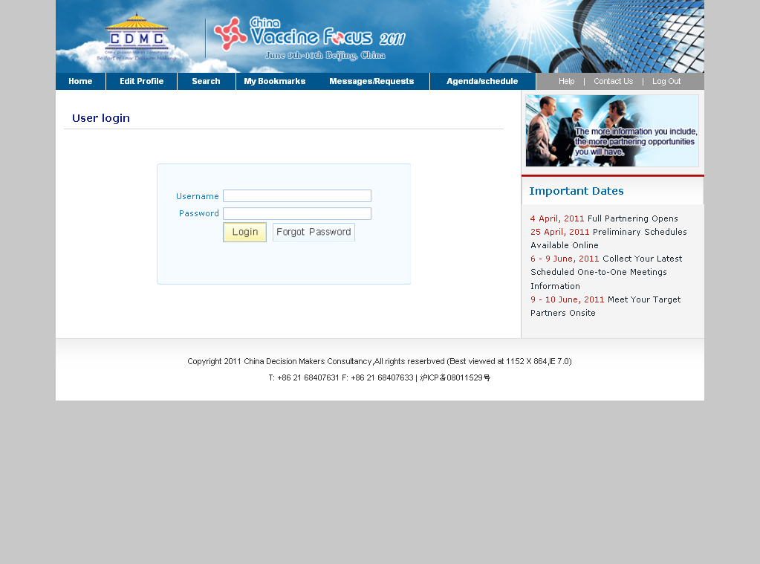
Type in Username, Password and log in this Online Partnering System.

Slide 2
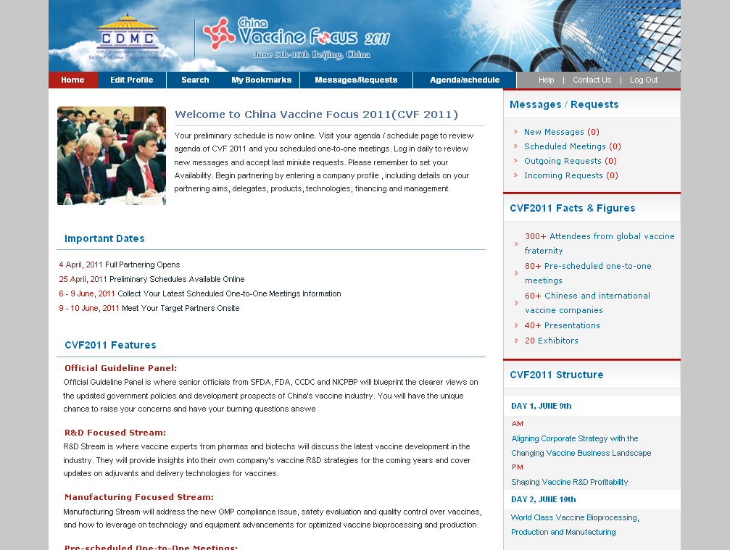
Homepage of this Partnering System where you can get to know Important dates, Messages/Requests/Structure and other information.
Overview of messages and requests sent out and received.

Slide 3

Key functions of this system: Edit Profile, Search, My Bookmarks, Messages/Requests and Agenda/Schedule.

Slide 4
Important dates to keep in mind.

Slide 5
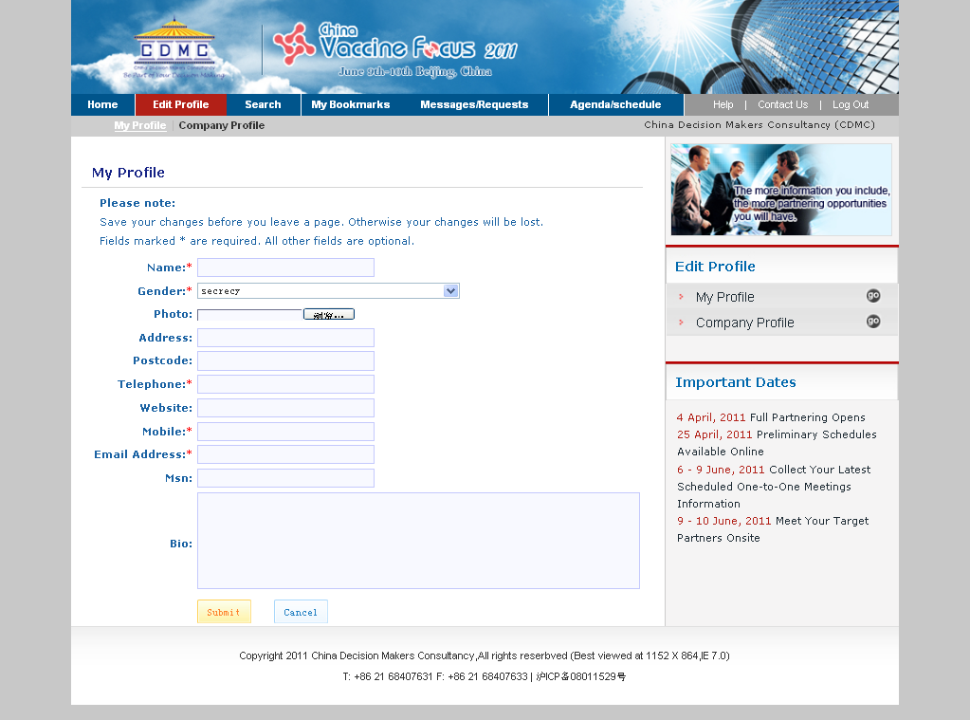
Complete and edit personal profile here. Fields with * are required. The more information you include, the more partnering opportunities you’ll have.

Slide 6
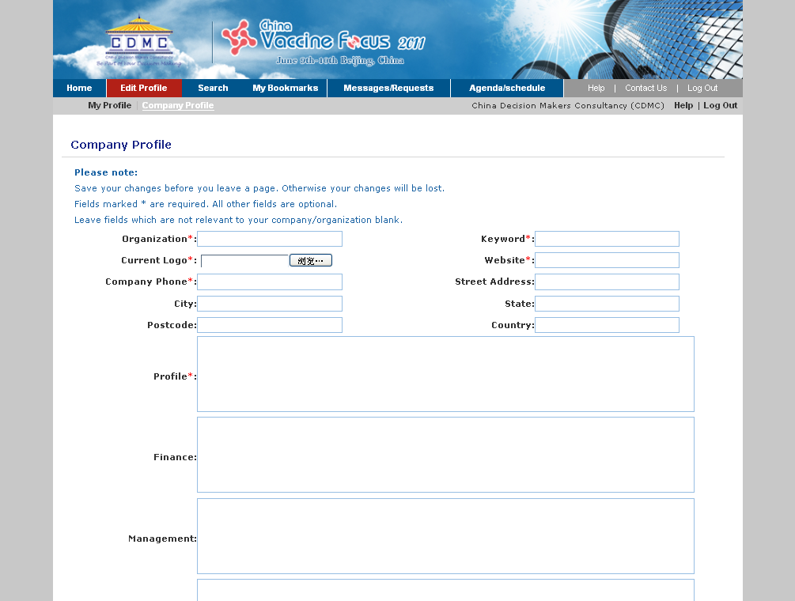
Complete and edit company profile here. Fields with * are required. The more information you include, the more partnering opportunities you’ll have.

Slide 7
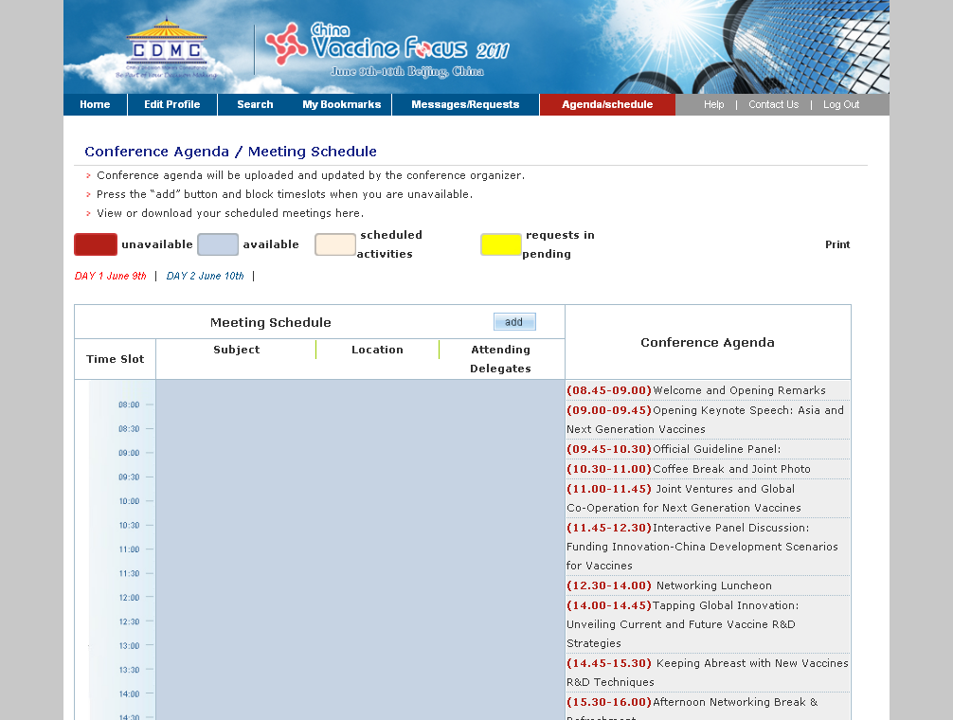
It’s a page of “Agenda / Schedule” where you can take an overview of conference agenda and set your personal availability or unavailability during the two days’ conference.
Overview of conference agenda.

Slide 8
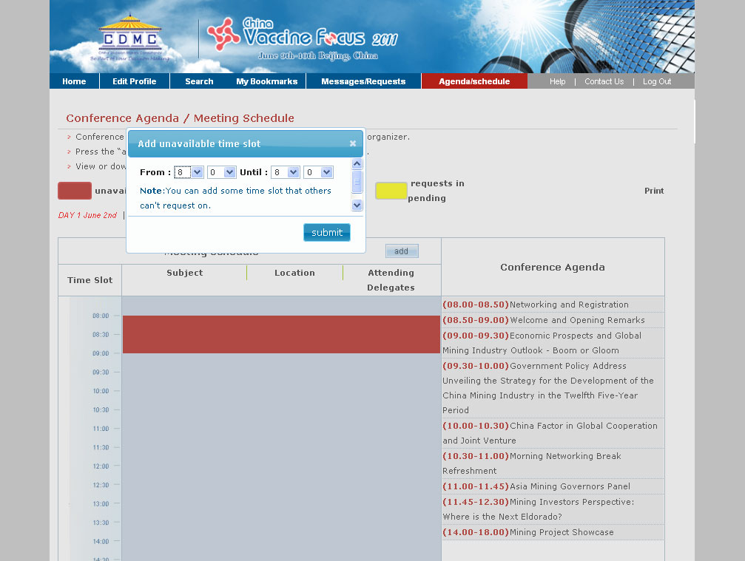
Press ADD here and set your unavailability when you are not willing to be requested for partnering meetings. After submission, this time slot will be marked red and double-click the red area to cancel.

Slide 9
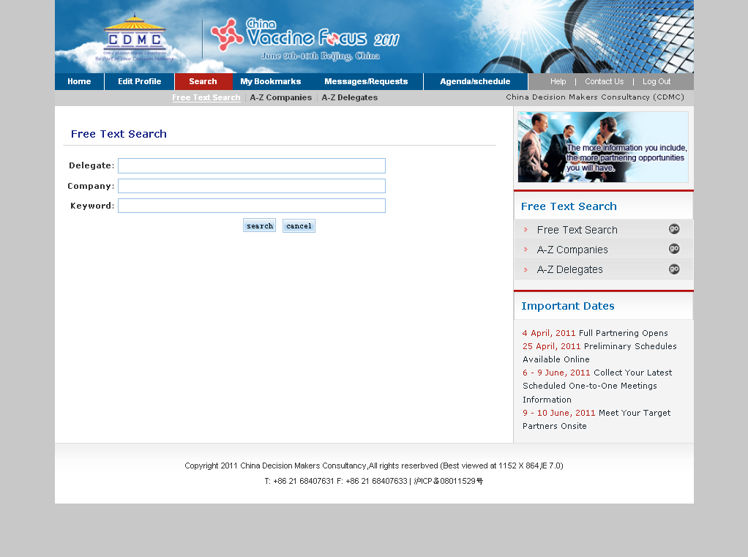
Free Text Search by delegate name, company name, keyword and screen out partnering aims. Book them into your bookmarks for future contact or request meetings immediately.

Slide 10
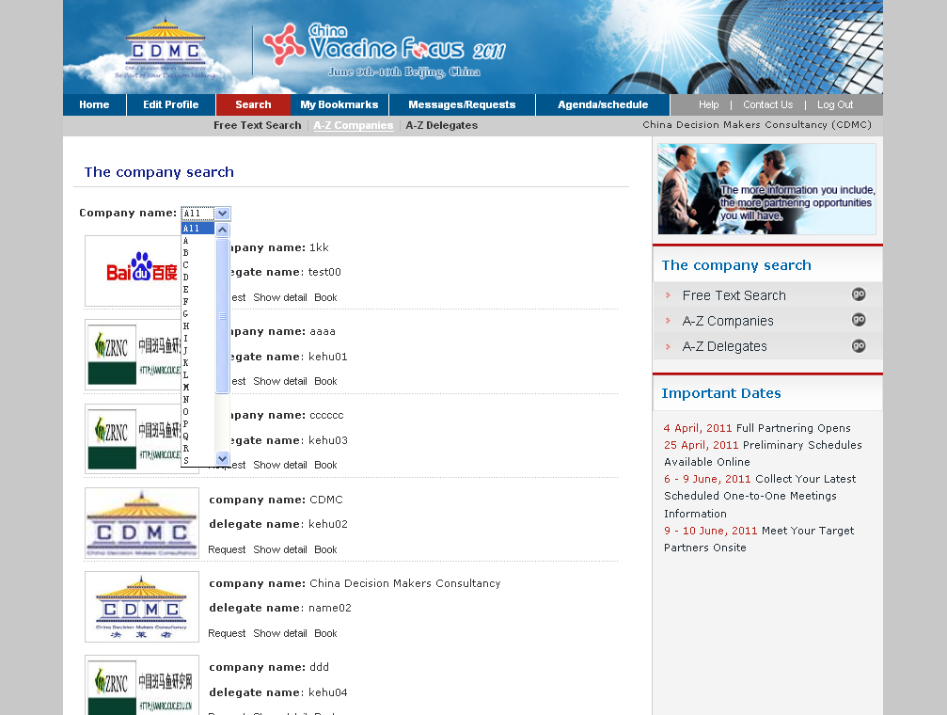
Exact search by company name and screen out partnering aims. Book them into your bookmarks for future contact or request meetings immediately.

Slide 11
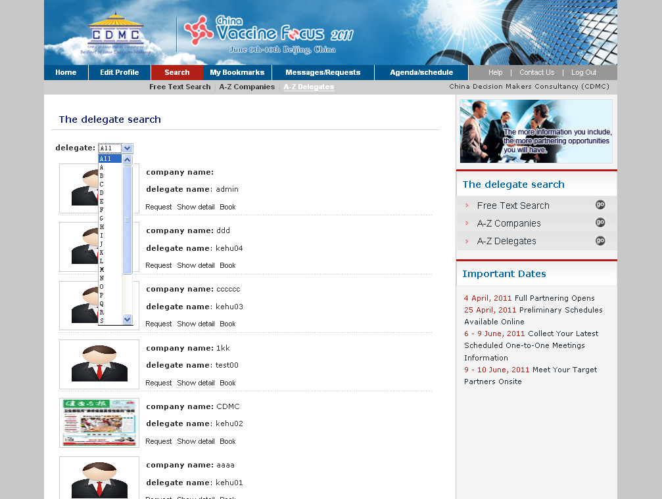
Exact search by delegate name and screen out partnering aims. Book them into your bookmarks for future contact or request meetings immediately

Slide 12
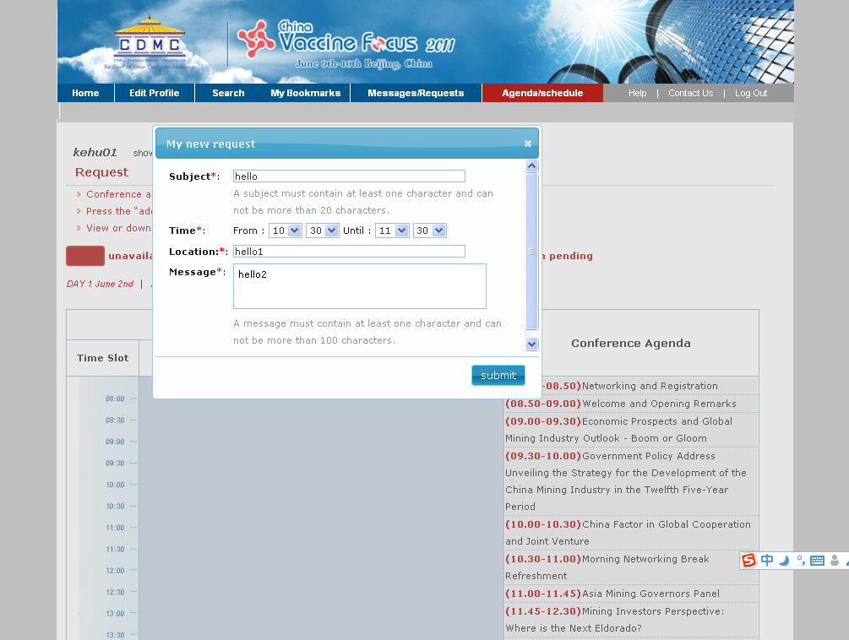
Page of requesting a meeting with potential partners. Click submit and send out your meeting request.

Slide 13
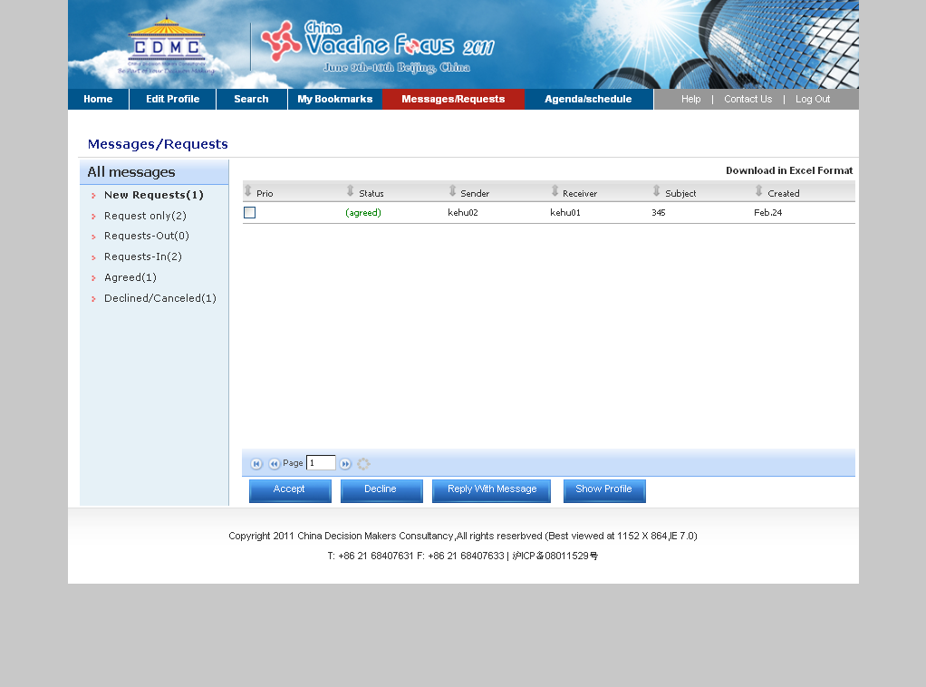
Page of detailed Messages/Requests. You can check messages/requests sent out and received. You can also reply with messages to conduct further communication with your partners.

Slide 14
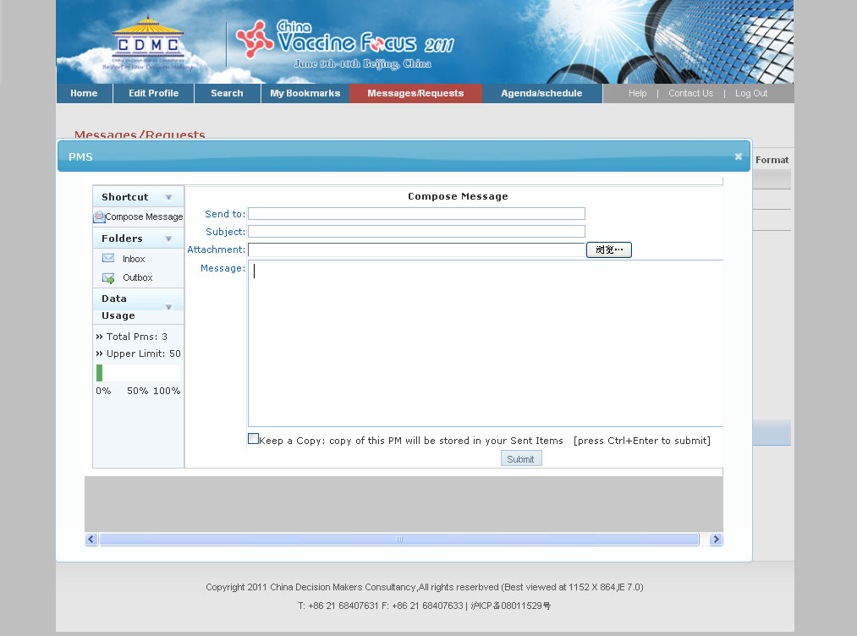
Page of “Reply with Message” where you can conduct further communication with your partners by text messages.

Slide 15
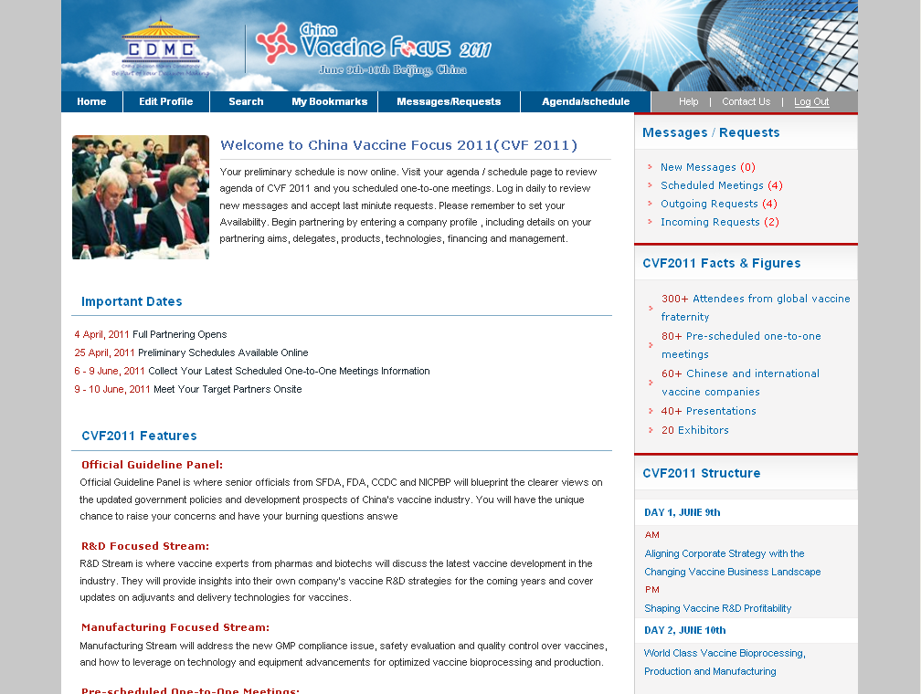
Log Out CDMC Online Partnering System.

